Slide 1
Advanced Topics on Soft Keyboard Design and Optimization
Xiaojun Bi
Stony Brook University
xiaojun@cs.stonybrook.edu
8/27/2018

Slide 2
My Background

Slide 3

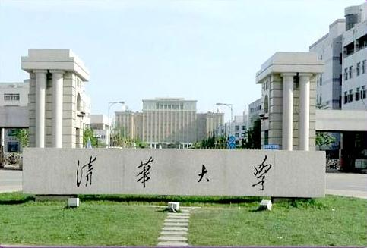




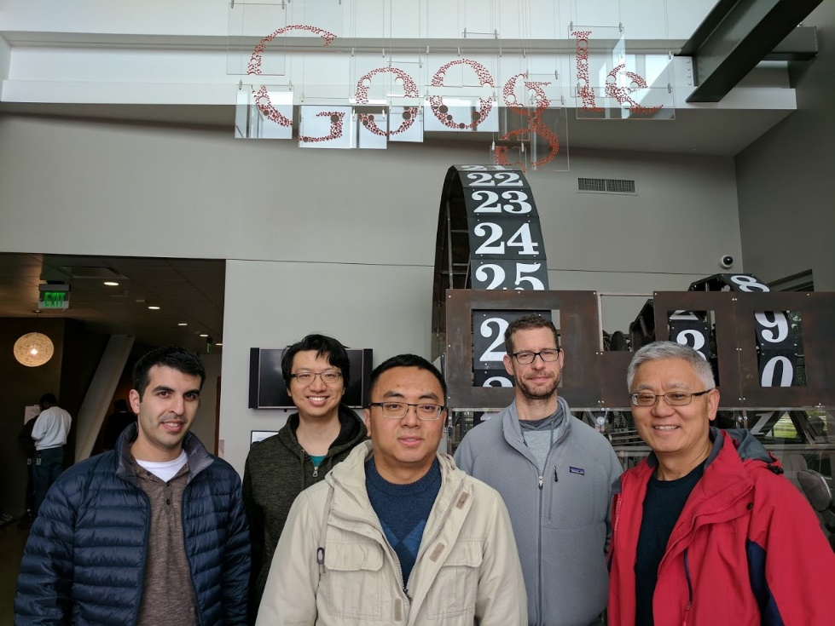



About Myself

Slide 4
Outline
Qwerty-Bounded Keyboard Layout Optimization
Multilingual Keyboard Layout Optimization
Keyboard Layout Optimization for Gesture Typing
Multi-Objective Optimization for Decoding Algorithm

Slide 5
Outline
Qwerty-Bounded Keyboard Layout Optimization
Multilingual Keyboard Layout Optimization
Keyboard Layout Optimization for Gesture Typing
Multi-Objective Optimization for Decoding Algorithm

Slide 6
Keyboard Layout Learning
MacKenzie and Zhang. The design and evaluation of a high-performance soft keyboard.
ACM CHI’99

Slide 7
Keyboard Layout Learning

Slide 8
Keyboard Layout Learning
Zhai, Sue, and Accot. Movement model, hits distribution and learning in virtual keyboarding. ACM CHI2002

Slide 9
How to improve learning?

Slide 10
Quasi-Qwerty Layout
Q | W | D | R | T | U | Y | L | K | P
Z | A | S | E | H | N | I | O | M
 | X | F | V | C | G | B | J
[Bi, Smith, Zhai. Quasi-Qwerty Soft Keyboard Optimization. ACM CHI2010]

Slide 11
Quasi-Qwerty Layout
Q | W | D | R | T | U | Y | L | K | P
Z | A | S | E | H | N | I | O | M
 | X | F | V | C | G | B | J
Qwerty
Q | W | E | R | T | Y | U | I | O | P
A | S | D | F | G | H | J | K | L
 | Z | X | C | V | B | N | M
[Bi, Smith, Zhai. Quasi-Qwerty Soft Keyboard Optimization. ACM CHI2010]

Slide 12
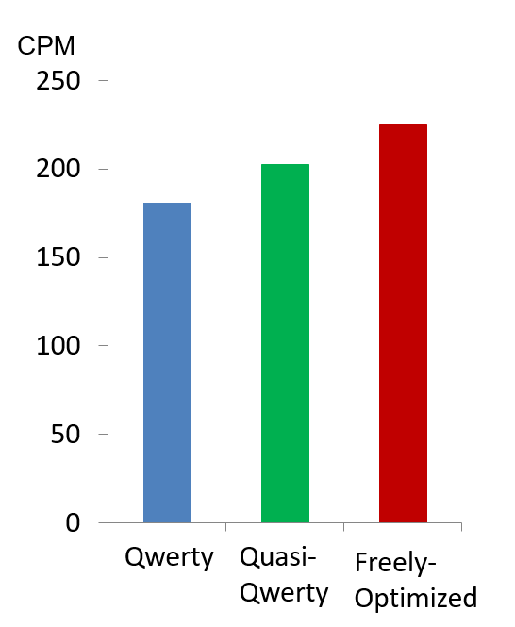
Expert Typing Speed
Initial Text Entry Time
[Bi, Smith, Zhai. Quasi-Qwerty Soft Keyboard Optimization. ACM CHI2010]

Slide 13
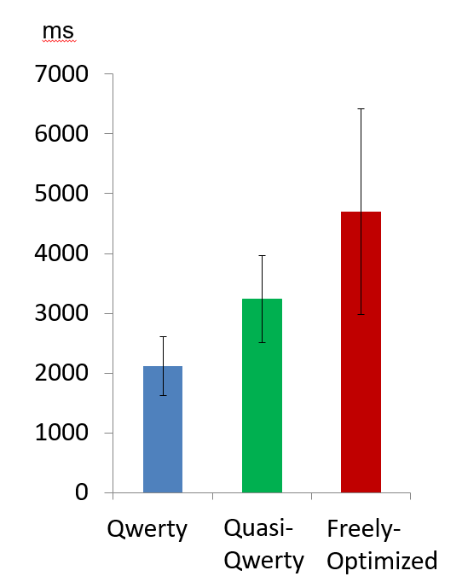
Expert Typing Speed
Initial Text Entry Time
[Bi, Smith, Zhai. Quasi-Qwerty Soft Keyboard Optimization. ACM CHI2010]

Slide 14
Outline
Qwerty-Bounded Keyboard Layout Optimization
Multilingual Keyboard Layout Optimization
Keyboard Layout Optimization for Gesture Typing
Multi-Objective Optimization for Decoding Algorithm

Slide 15
Qwerty Layout
Q | W | E | R | T | Y | U | I | O | P
A | S | D | F | G | H | J | K | L
 | Z | X | C | V | B | N | M
Qwerty is inefficient for touch screen text entry.

Slide 16
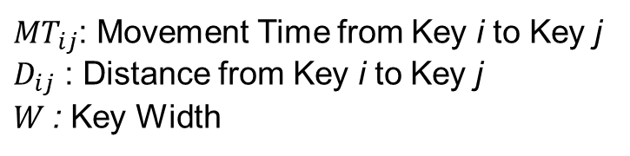
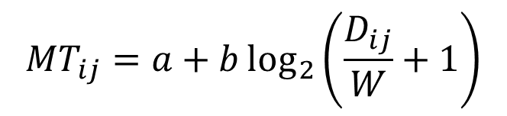
Optimization Objective Function
Fitts’ Law (Fitts 1954):
$${MT}_{ij}=a+b\log_{2}\left(\frac{D_{ij}}{W}+1\right)$$
${MT}_{ij}$: Movement Time from Key i to Key j
$D_{ij}$ : Distance from Key i to Key j
$W$: Key Width

Slide 17
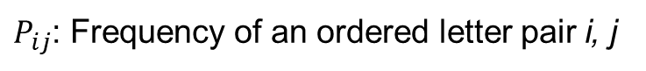
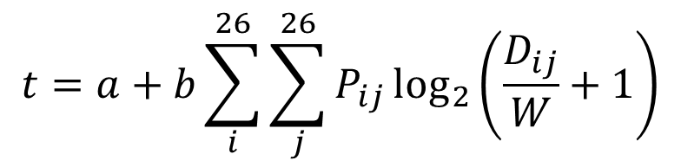
Optimization Objective Function
Fitts’ Law (Fitts 1954):
$${MT}_{ij}=a+b\log_{2}\left(\frac{D_{ij}}{W}+1\right)$$
${MT}_{ij}$: Movement Time from Key i to Key j
$D_{ij}$ : Distance from Key i to Key j
$W$: Key Width
Average time of typing a letter:
$$t=a+b{\sum_{i}^{26}{\sum_{j}^{26}{P_{ij}}}log}_{2}\left(\frac{D_{ij}}{W}+1\right)$$
$P_{ij}$: Frequency of an ordered letter pair i, j

Slide 18
Layout Optimized for English
K-English
Z | J | D | G | K
Y | L | N | I | C
F | O | A | T | H | W
B | U | R | E | S
Q | P | M | V | X
[Bi, Smith, Zhai. Multilingual Touchscreen Keyboard Design and Optimization
Human-Computer Interaction 2012]
Notes:
In comparison to layouts individually optimized for each language, which are also obtained in this paper, simultaneously optimizing for multiple languages caused only a minor performance degradation for each language.
to reduce the burden of multilingual users having to switch and learn new layouts for different languages
comparison to QWERTY’s 3.31, 3.51, 3.7, 3.26, 3.85 keys of movement for English, French, Spanish, German and Chinese respectively, the optimized multilingual layout has an average travel distance of 1.88, 1.86, 1.91, 1.77 and 1.68 keys

Slide 19
Language Usage
The number of languages: 6000 ~ 8000
Trilingual
(13%)
Monolingual
(40%)
Bilingual
(43%)

Slide 20
Layout Optimization for English and French
Letter Frequency
r = 0.88

Slide 21
Layout Optimization for English and French
Digraph Frequency
r = 0.75

Slide 22
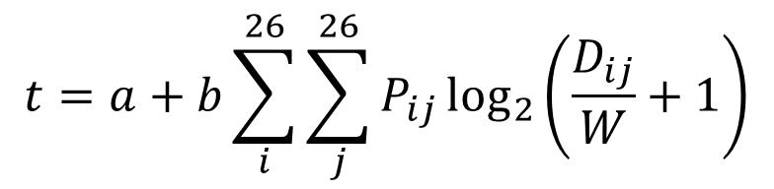
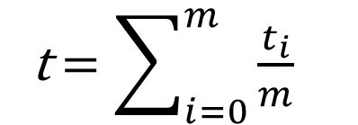
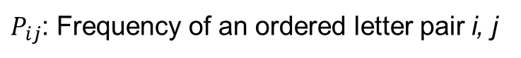
Optimization Objective Function
Average time of typing a letter:
$$t=a+b{\sum_{i}^{26}{\sum_{j}^{26}{P_{ij}}}log}_{2}\left(\frac{D_{ij}}{W}+1\right)$$
$P_{ij}$: Frequency of an ordered letter pair i, j
Average time of typing a letter across m languages
t$=\sum_{i=0}^{m}{\frac{t_{i}}{m}}$

Slide 23
Optimized Layouts

Slide 24
Performance

Slide 25
Performance

Slide 26
Layout Optimization for 5 Languages

Slide 27
Layout Optimization for 5 Languages

Slide 28
Optimized Layouts

Slide 29
Performance

